Slide 1
Recitation 13

Slide 2
Info
Jon Rutkauskas
Recitation: Tue 12-12:50
Office Hours: Tue 11-11:50 Thur 11-12:50 SENSQ 5806 (additional hours by appointment if needed)
On discord: @jrutkauskas
By email: jsr68@pitt.edu
Website: https://github.com/jrutkauskas/spring2019-449-rec
Ask me any questions you have!!!

Slide 3
Warmup PollS

Slide 4
“Stick” Around…
Still have stickers!
Also, an extra surprise to everyone who came to this final recitation

Slide 5
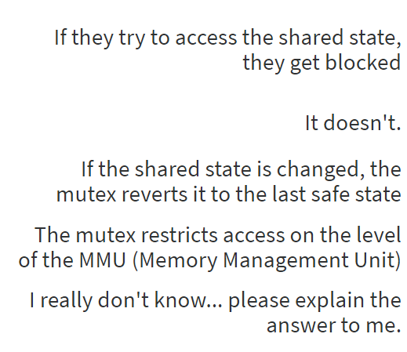
How does a Mutex keep shared memory from being messed up by a noncooperating thread?

Slide 6
How does a Mutex keep shared memory from being messed up by a noncooperating thread?
Threads only get blocked when they try to lock the mutex when it’s already locked.
Mutexes don’t actually change the way we access the actual shared state, we just agree to lock and unlock the mutex around the access
There’s no transaction history with mutexes; if you want something like that, have a look at DBMSs
The MMU has no concept of mutexes and is not affected by them
Remember – Mutexes are just an additional tool to ensure we don’t access shared state out of our turn, but they only work if we use them; they don’t actually change the memory access

Slide 7
OMETS!
Please do them. You’ll get cookies (and subsequently, I might get cookies as well) These cookies are worth it
Also, there may or may not be a TA evaluation sent to you. I do appreciate feedback.

Slide 8
Final Exam
That thing’s coming up
Look over class slides, example code, etc.
You already have a bunch of practice questions you can go through
https://github.com/jrutkauskas/spring2019-449-rec
Also the recitation slides
Also, I’m here to help:

Slide 9
Finals Week OH
Available on Discord anytime!
During finals week in regular 5806 SENSQ (may get better room if full):
Tuesday from 12:00pm – 1:00pm
Wednesday from 10am – 12pm
Friday from 1pm – 3pm
Come to review, look over code, ask about any concept, go over slides, or even just to study.

Slide 10
For the remainder of this class
Finals questions. I’ll have an anonymous poll
Lab 9 (AKA Project 5) – Making a device / driver
https://jarrettbillingsley.github.io/teaching/classes/cs0449/labs/lab9.html
Setup VM – harder on macs
Make a demo driver (code given)
Make a basic driver – pretty fun!

Slide 11

Thanks for a Great Semester!

